Slide 1
7
Basic Elements of Planning

Slide 2
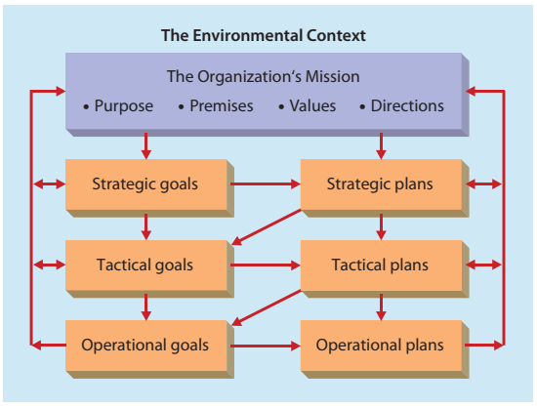
Flowchart of Planning Function
Educated Balochistan
The Organization’s Vision
Building schools in different areas of Balochistan
Total Budget, Maps, Funds etc for 10 years
Building 60 Schools in 10 years
Building 30 Schools in 5 years
Total Budget, Maps, Funds etc for 5 years
Building 6 Schools in 1 year.
0.5 school in 1 month
Total Budget, Maps, Funds etc for 1 year, upto 1 month and 1 day

Slide 3
Operational Plans
Single Use Plans
Standing Plans

Slide 4
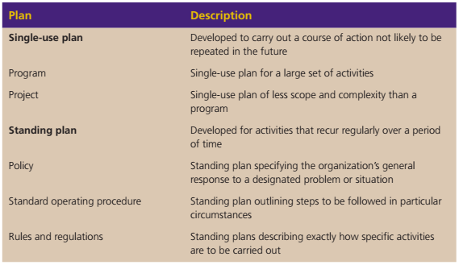
Types of Operational Plans

Slide 5

Barriers to Goal Setting and Planning
Major Barriers
Inappropriate goals.
Improper reward system.
Dynamic and complex environment.
Reluctance to establish goals.
Resistance to change.
Constraints.

Slide 6

Barriers to Goal Setting and Planning
Overcoming Barriers
Understanding the purposes of goals and planning.
Communication and participation.
Consistency, revision, and updating.
Effective reward system.

